Slide 1
Regional Dialect Identification for African American English Speakers
EC ENGR M214A
Final Project Presentation
Group 3
Ajit Pandey
Partha Kundu
Lindsey Smith

Slide 2

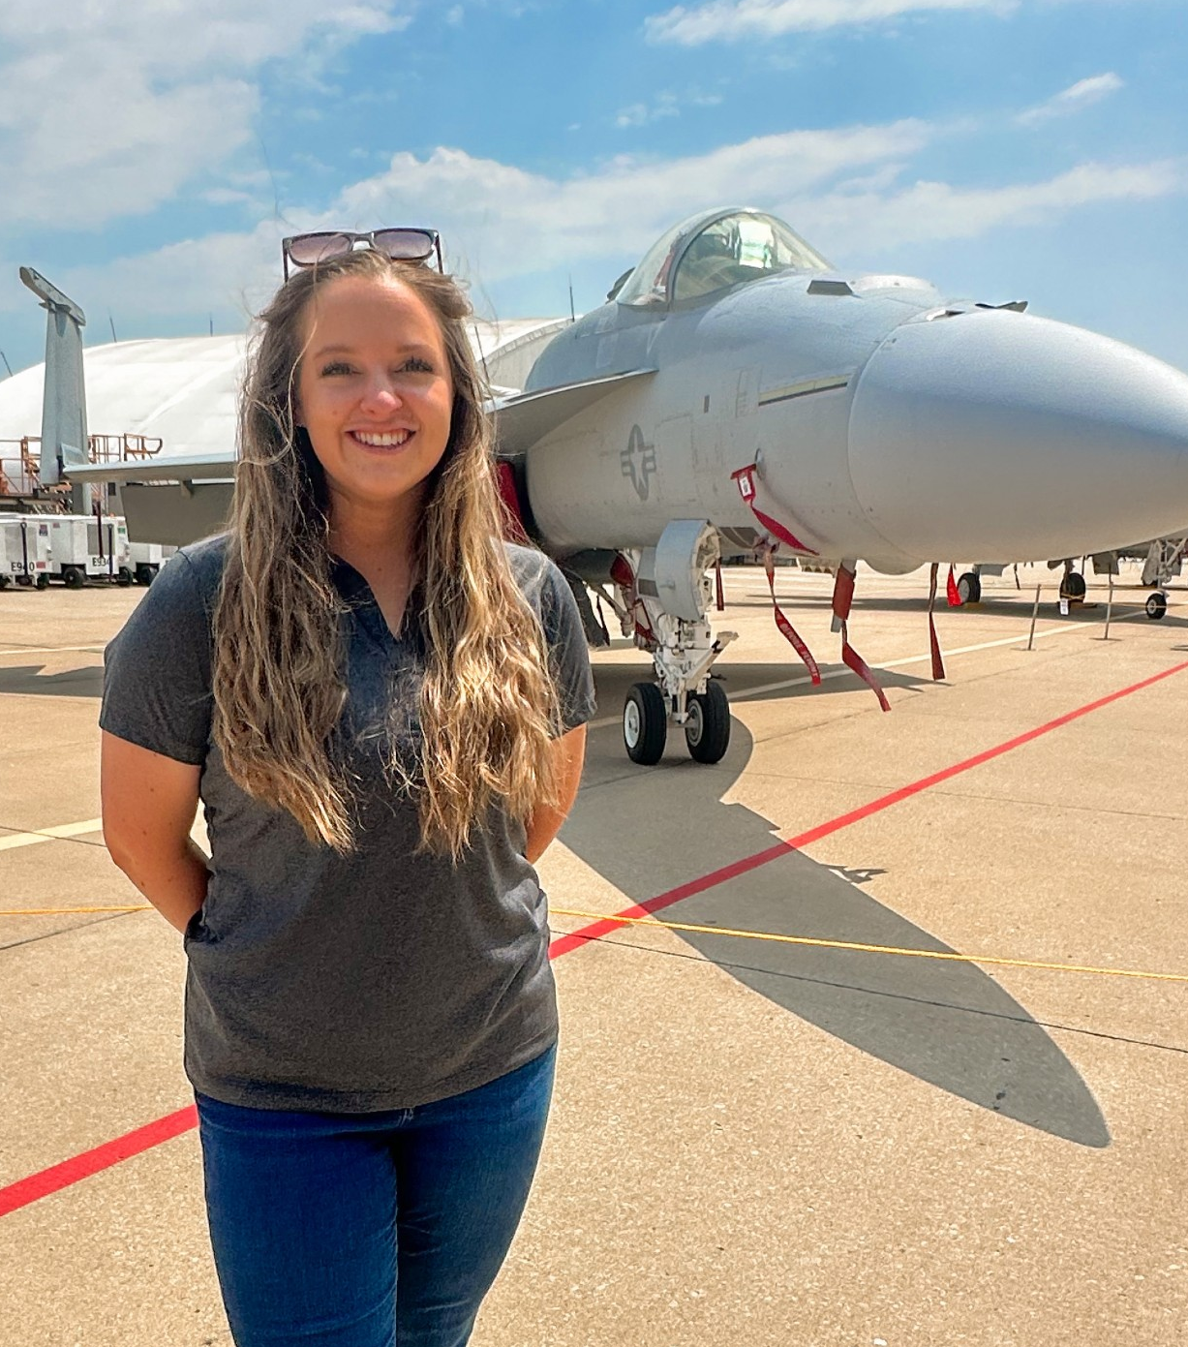
Meet the team
Ajit Pandey
Placeholder
Partha Kundu
Placeholder
Lindsey Smith
Electrical Engineer

Slide 3

Agenda
Introduction
Approach
Filtering
Feature Selection
Final Results
Conclusions

Slide 4
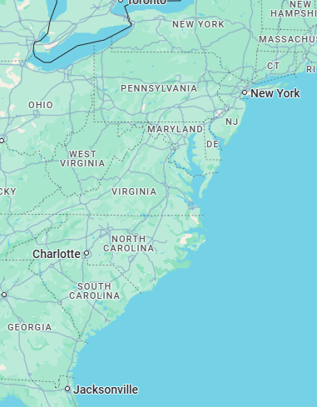
Introduction
Speech signals carry characteristic information about the originating speaker including regional origin
This project uses audio signals from the Corpus of Regional African American Language (CORAAL) database to train and establish an African American speaker region identification system
The dataset is taken from male and female speakers from 6 U.S. cities speaking within noisy and clean environments
Different features are extracted from the audio files in the dataset which are then used to train an XGBoost classifier to predict the area of origin for each speaker
The objective of this project is to exceed an accuracy threshold of ~70% through strategic feature selection
Detroit, MI
Rochester, NY
Lower East Side, Manhattan, NY
Washington, DC
Princeville, NC
Valdosta, GA

Slide 5
High level Approach
Import audio data
Preprocess data
Apply filtering
Extract feature sets
Create labels
Concatenate data
Train model
Test model
Extract and plot results

Slide 6
Filtering Methods: Whitening Filter
What is a whitening filter
Why we chose to use it
How it worked for our code
How and where it was implemented in our code
Results

Slide 7
Filtering Methods: Spectral gating Filter
What is a spectral gating filter
Why we chose to use it
How it worked for our code
How and where it was implemented in our code
Results

Slide 8
Feature Extraction: mfcc
MFCC description
Why we chose to use it
How it worked for our code
Results – accuracy improvement or degradation
Results - data

Slide 9
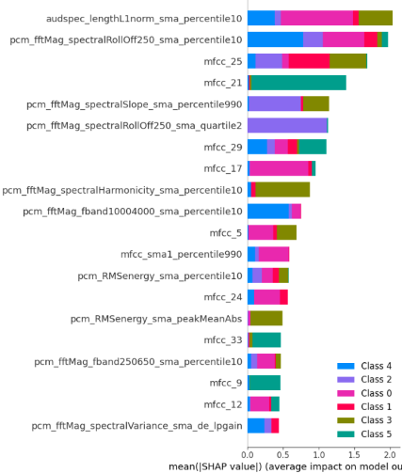
Feature Extraction: openSMILE – ComParE_2016
ACCURACY
Train (Clean) | 100%
Test (Clean) | 65.2%
Test (Noisy) | 62.8%
Open Smile description
ComParE description
Why we chose to use it
How it worked for our code
Results – accuracy improvement or degradation
mfcc13 + ComParE_2016
Results – data
*add observation about errors / error analysis

Slide 10
Feature Extraction: openSMILE – GeMAPSv01b and eGeMAPSv02
GeMAPSv01b description
eGeMAPSv02 description
Why we chose to use it
How it worked for our code
Results – accuracy improvement or degradation
Results - data

Slide 16
Final best Results

Slide 17
Conclusions

Slide 18
Speaking engagement metrics​
Impact factor​ | Measurement​ | Target​ | Achieved​
Audience interaction​ | Percentage (%)​ | 85​ | 88​
Knowledge retention​ | Percentage (%)​ | 75​ | 80​
Post-presentation surveys​ | Average rating​ | 4.2​ | 4.5​
Referral rate​ | Percentage (%)​ | 10​ | 12​

Slide 19
Questions?

